Slide 1
EHDA closed loop control system based on real time non-visual spray mode classification
WAC High Voltage lab
Student: Joao Pedro M Marques
Supervisor: Luewton L F Agostinho
Notes:
Name, Luewtons name,

Slide 2
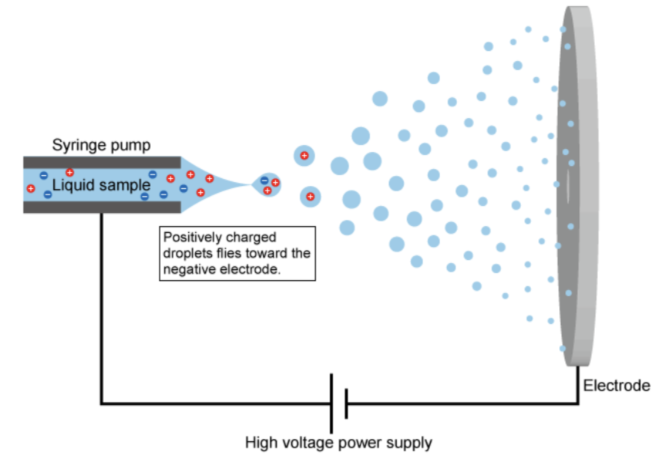
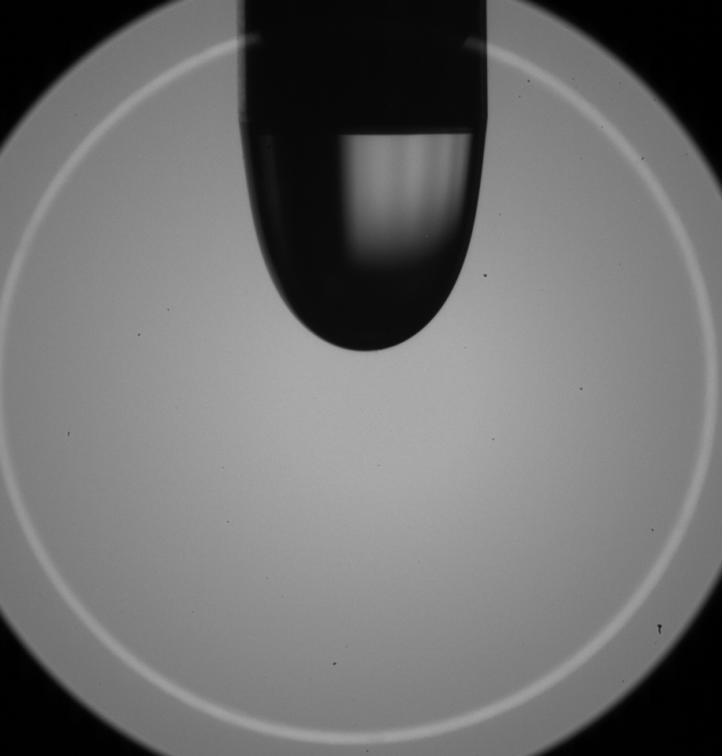
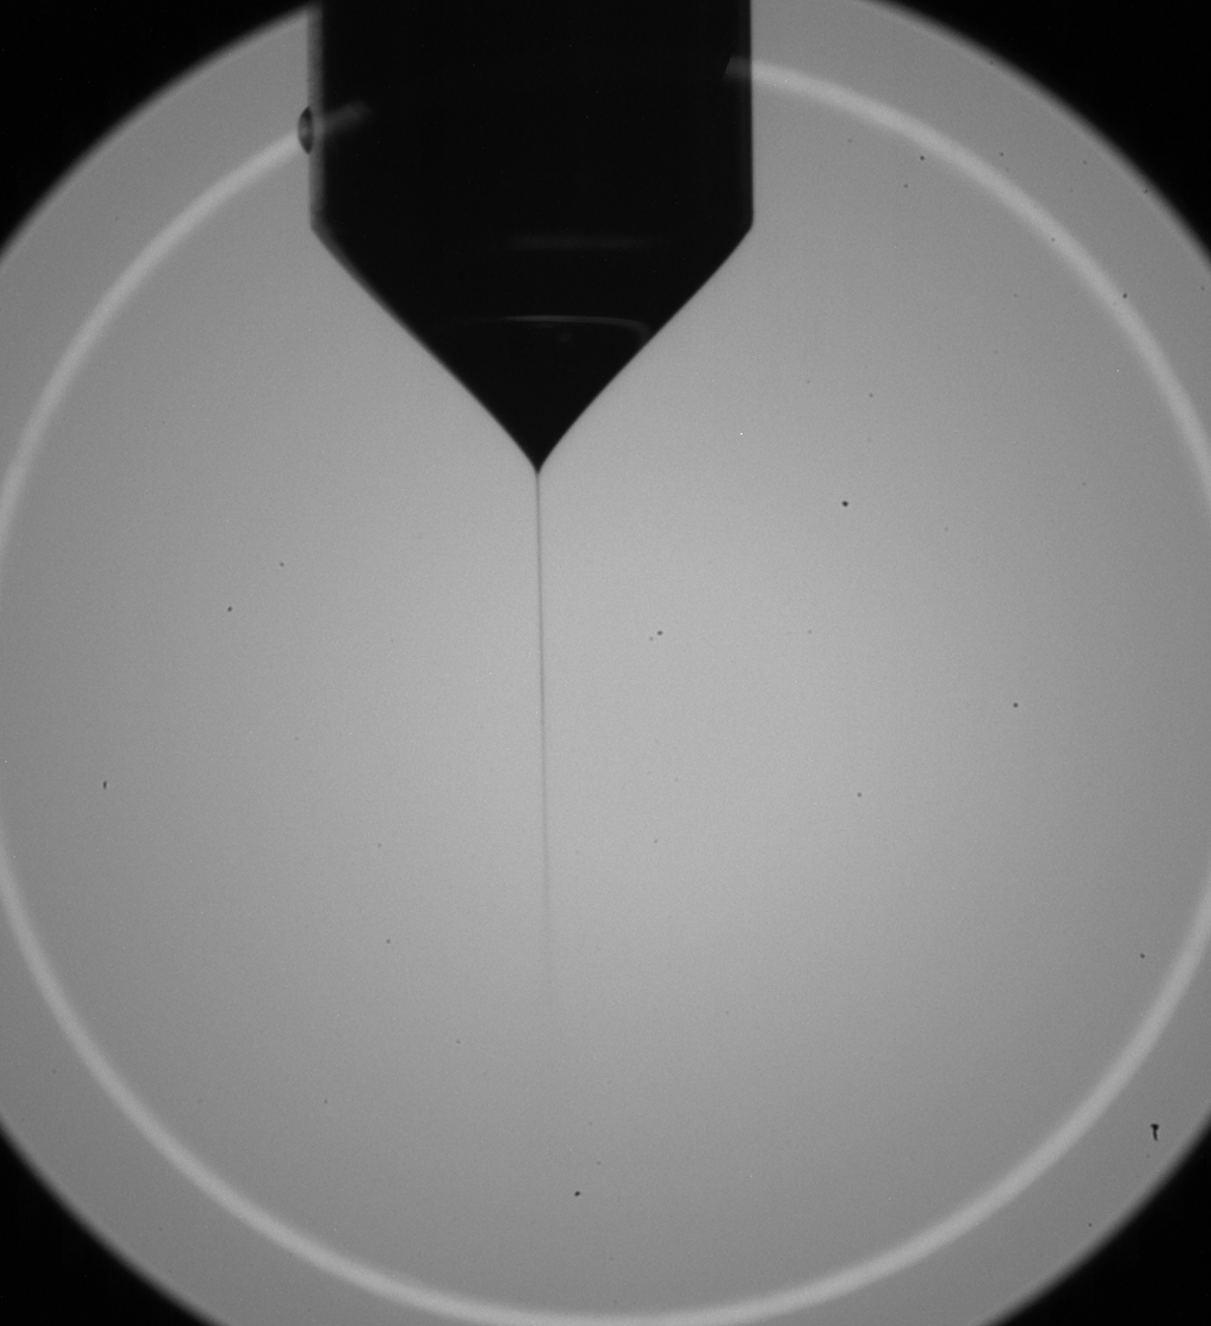
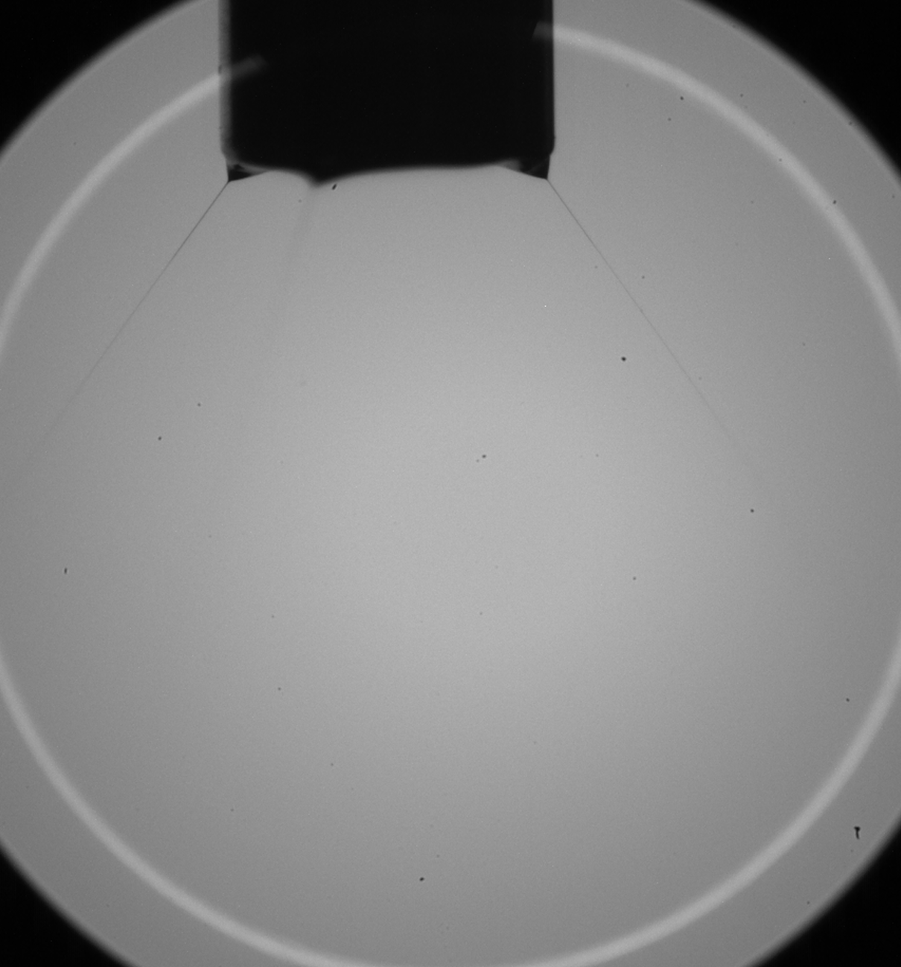
EHDA Electrohydrodynamic Atomization
A process where a liquid jet breaks up into droplets under influence of electrical forces
Applications:
Medical
Chemical Industries
Gas odorizer
Source: google images
Goals:
Automation
Spray Classification
Spray mode Control
Dripping
Cone Jet
Multi Jet

Slide 3
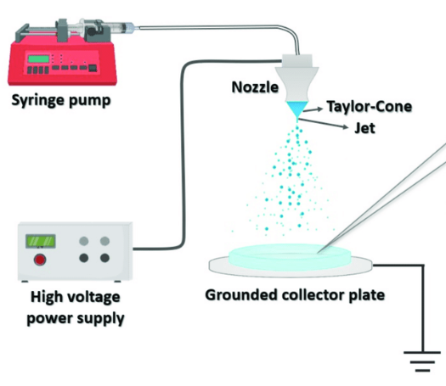
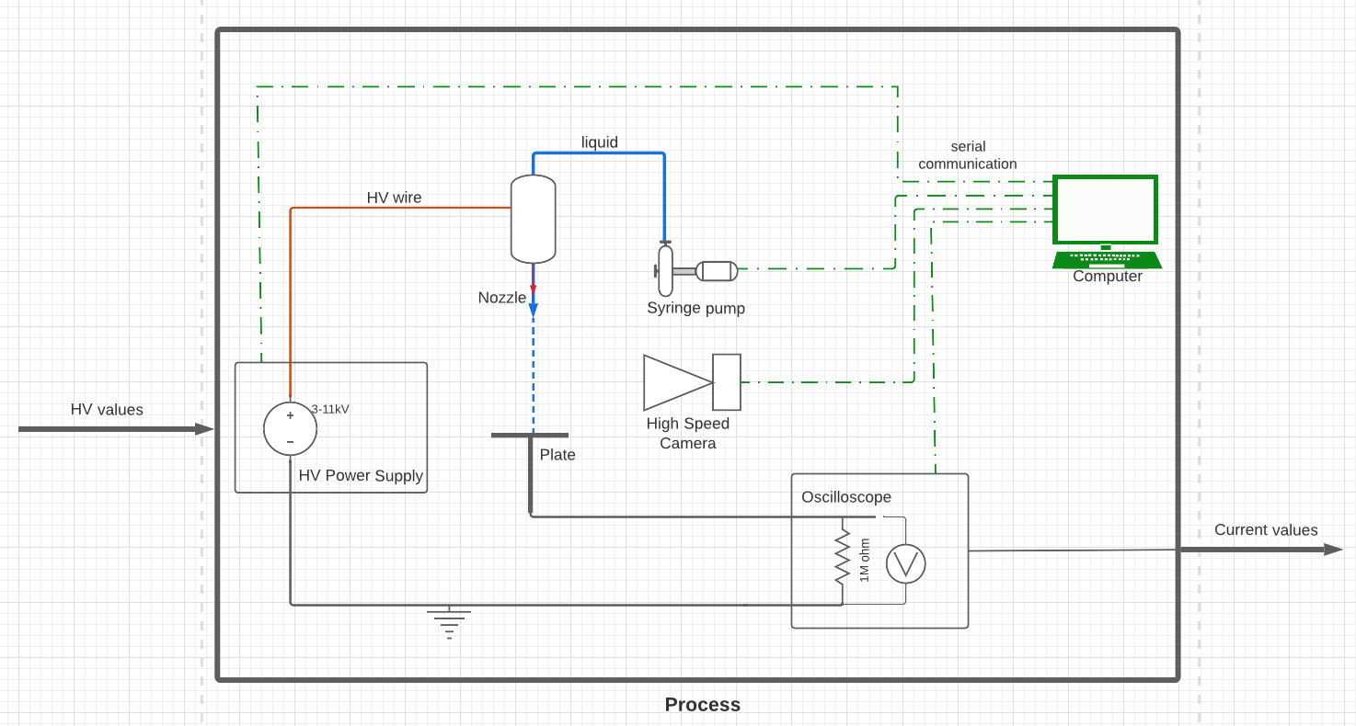
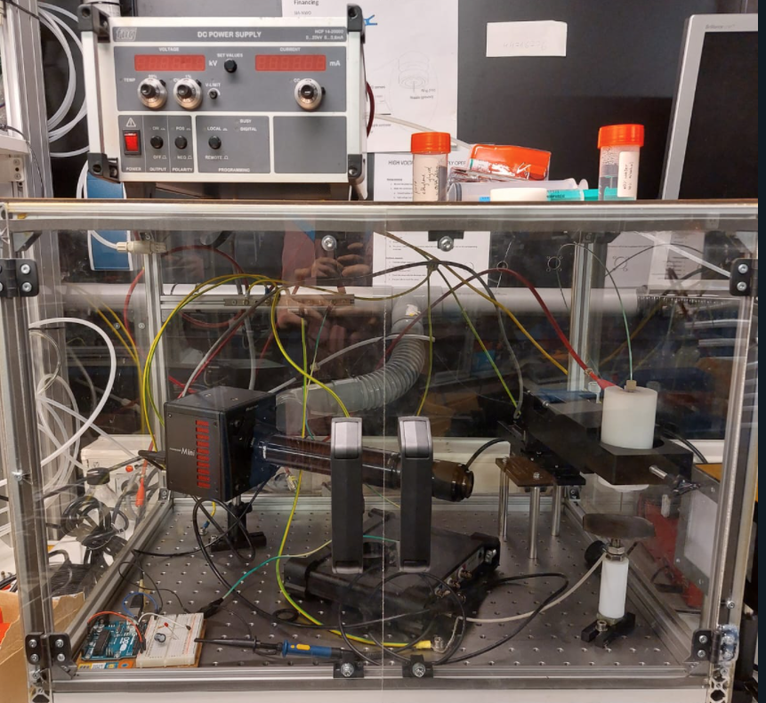
1 - Automation System
Scheme of the Process

Slide 4
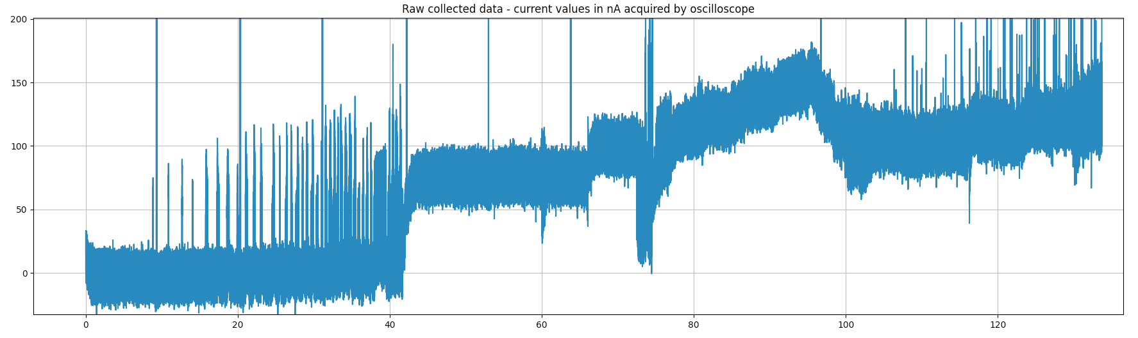
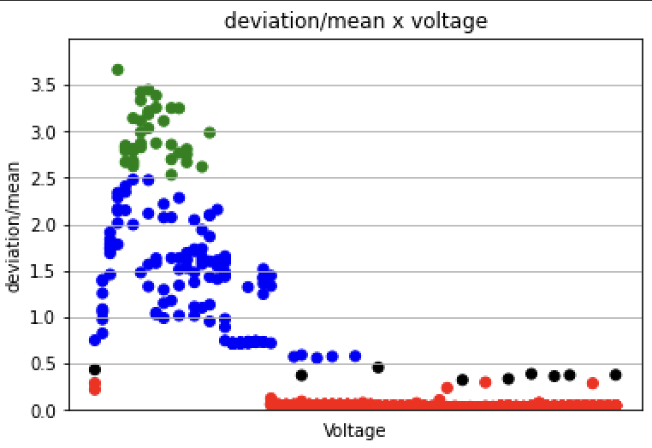
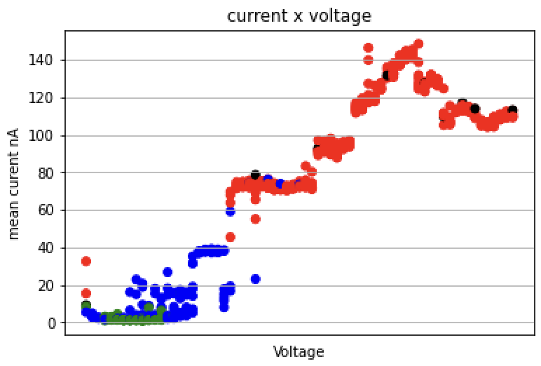
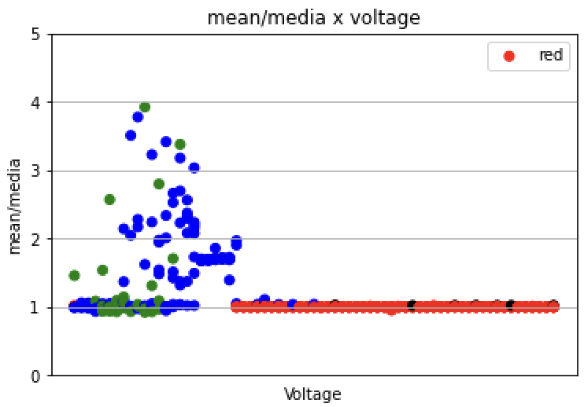
2 - Classification
Sjaaks, xxxx statisticals relations:

Slide 5
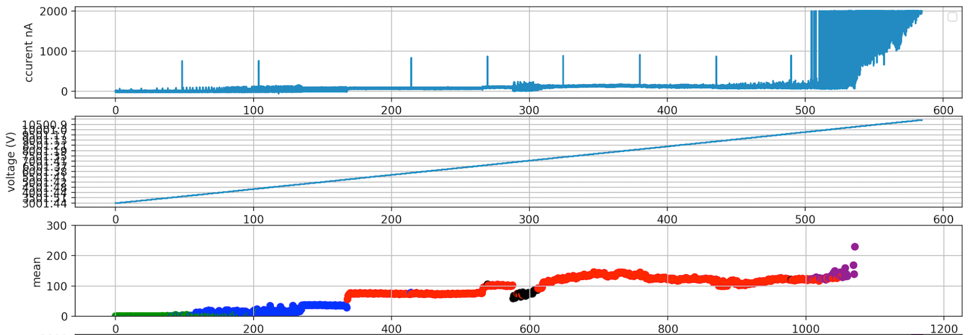
2 - Classification
Algorithm being used: Statistical Analysis - deviation/mean
EXPERIMENT: Tstep = 5s ; Vstep = 50V
Dripping
Intermittent
Cone Jet
Multi Jet - Not Classified
Corona Sparks

Slide 6
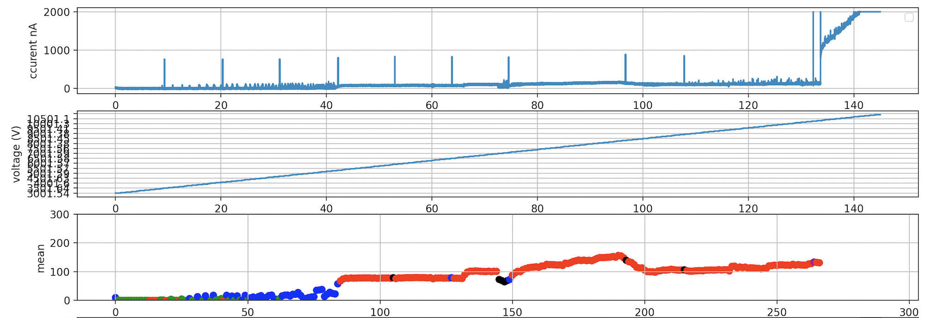
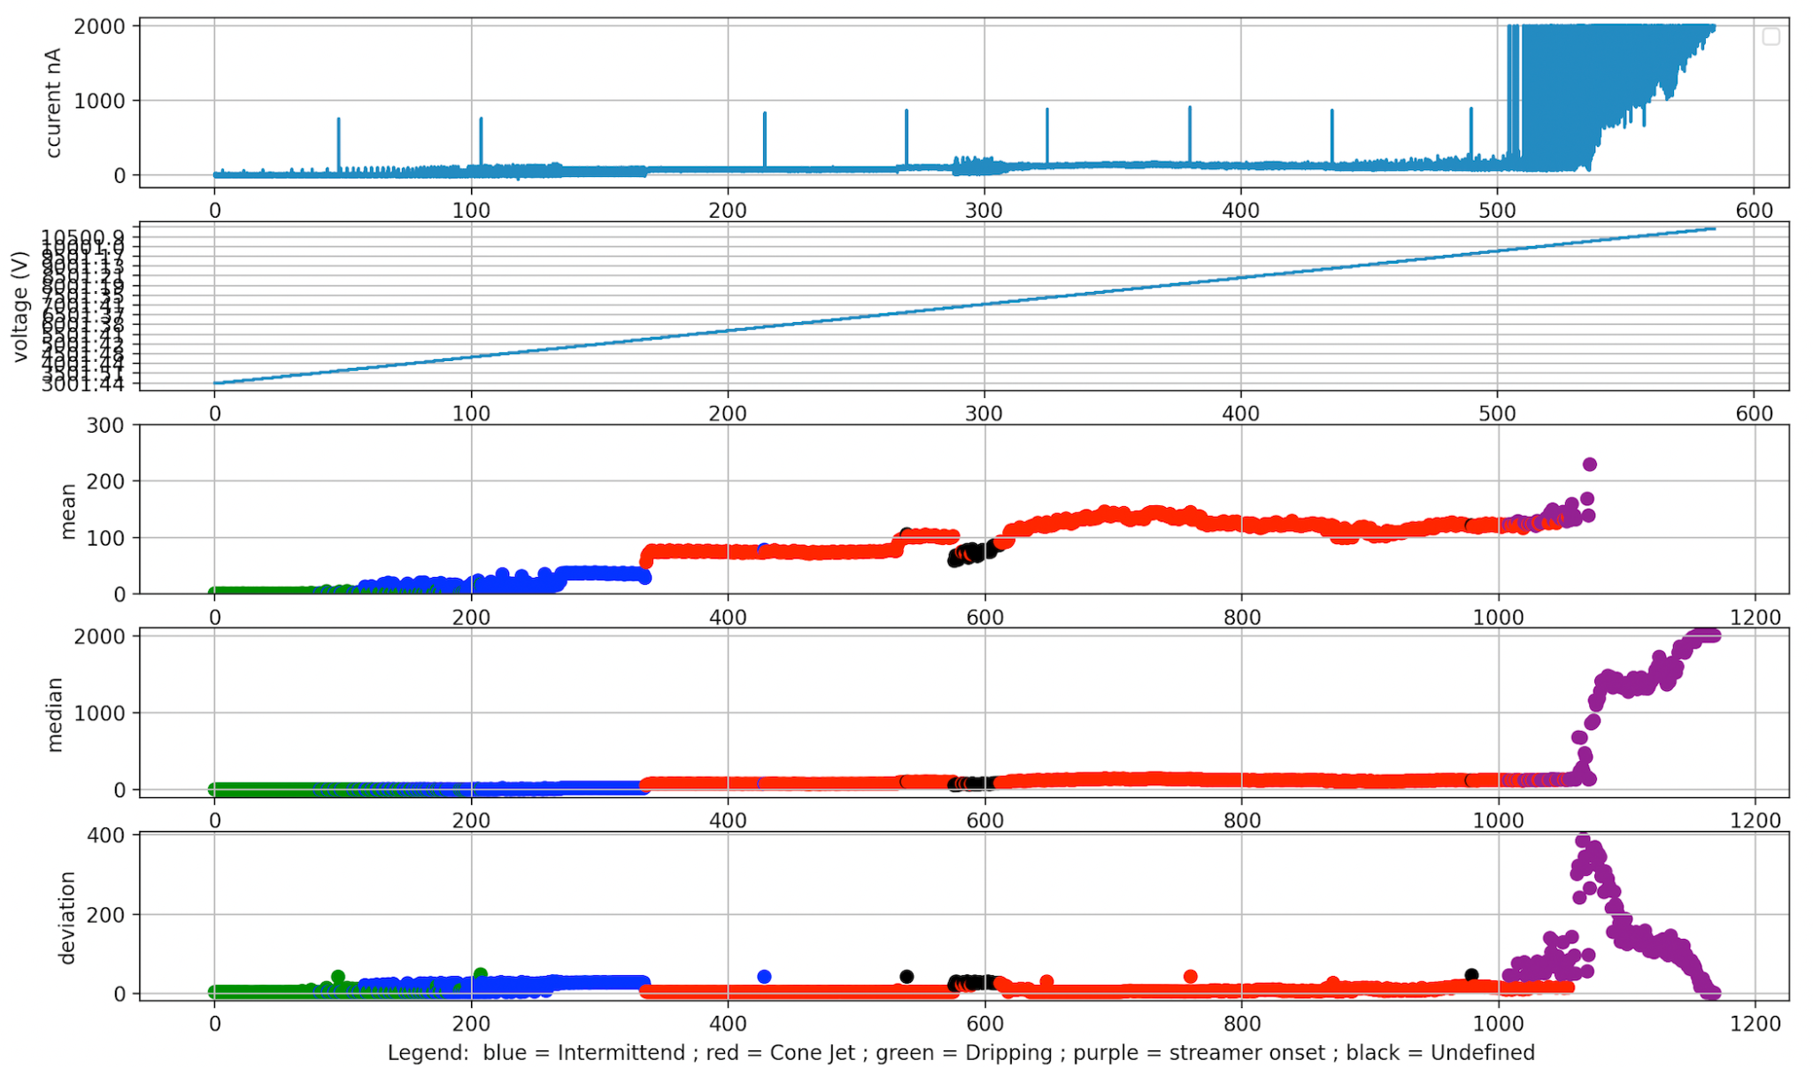
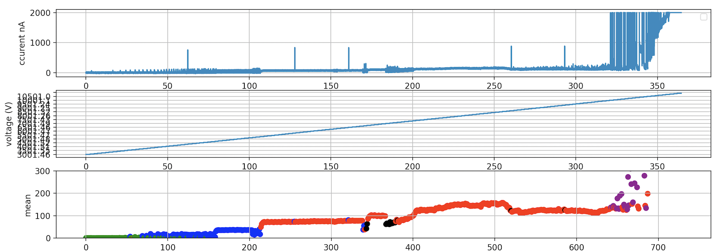
More Experiments
Tstep 1s Vstep 50V
Tstep 5s Vstep 50V
Tstep 3s Vstep 50V

Slide 7
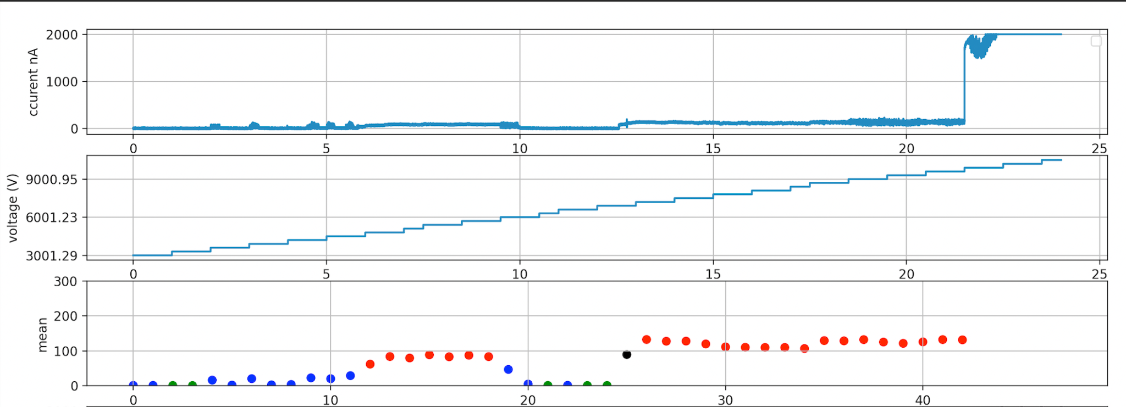
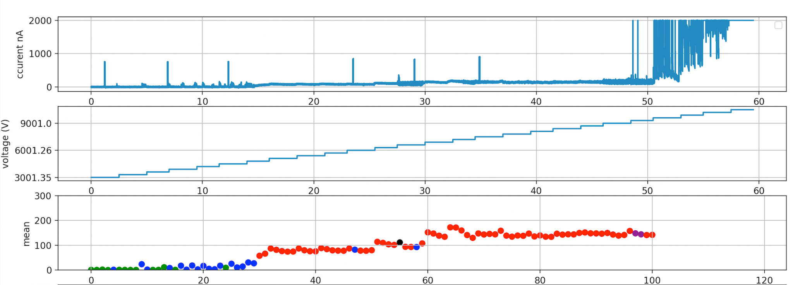
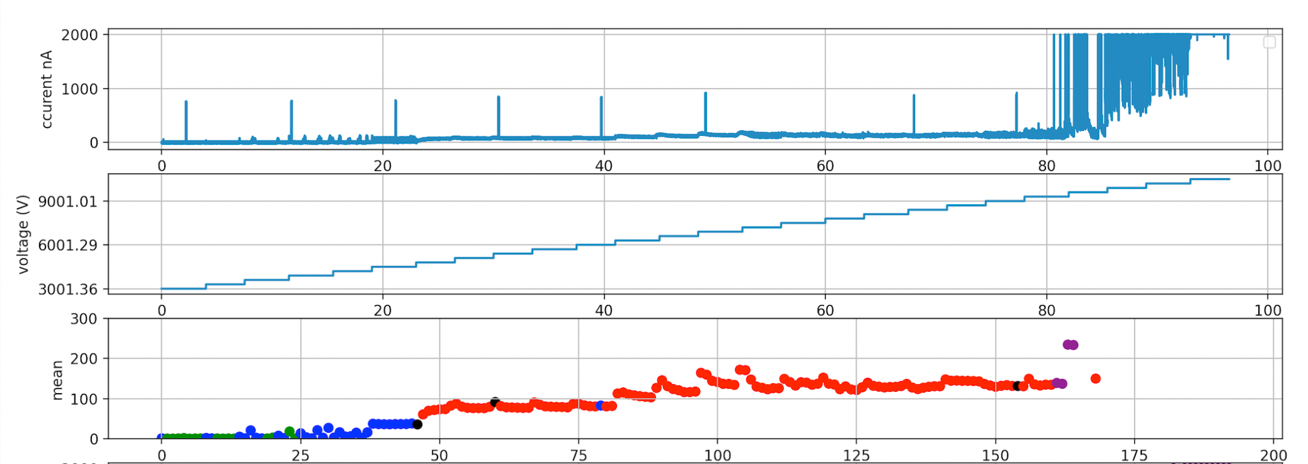
More Experiments
Tstep 1s Vstep 500V
Tstep 3s Vstep 500V
Tstep 5s Vstep 500V

Slide 8
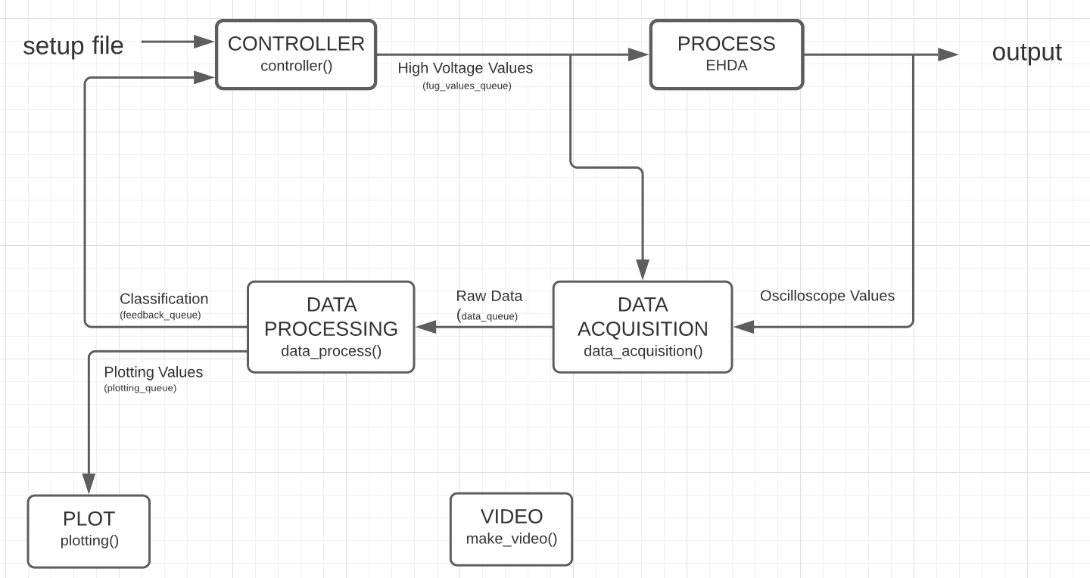
3 - Control System

Slide 9
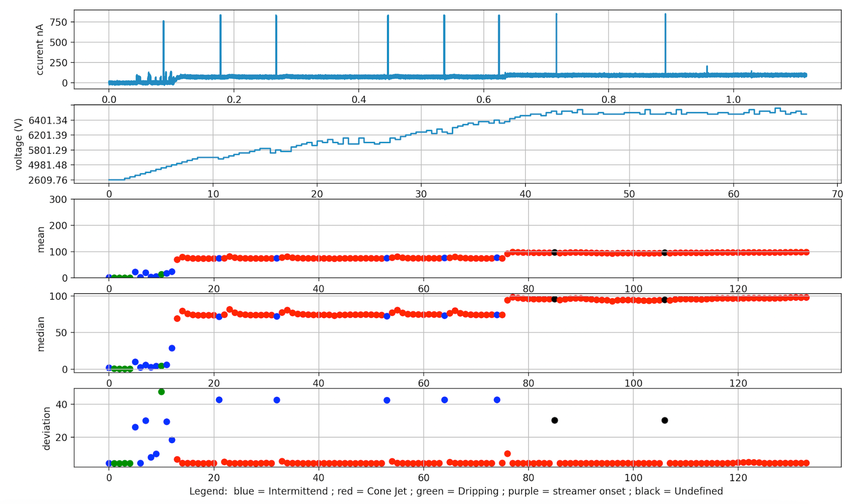
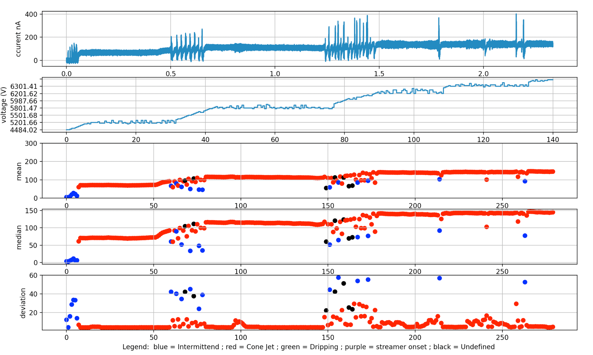
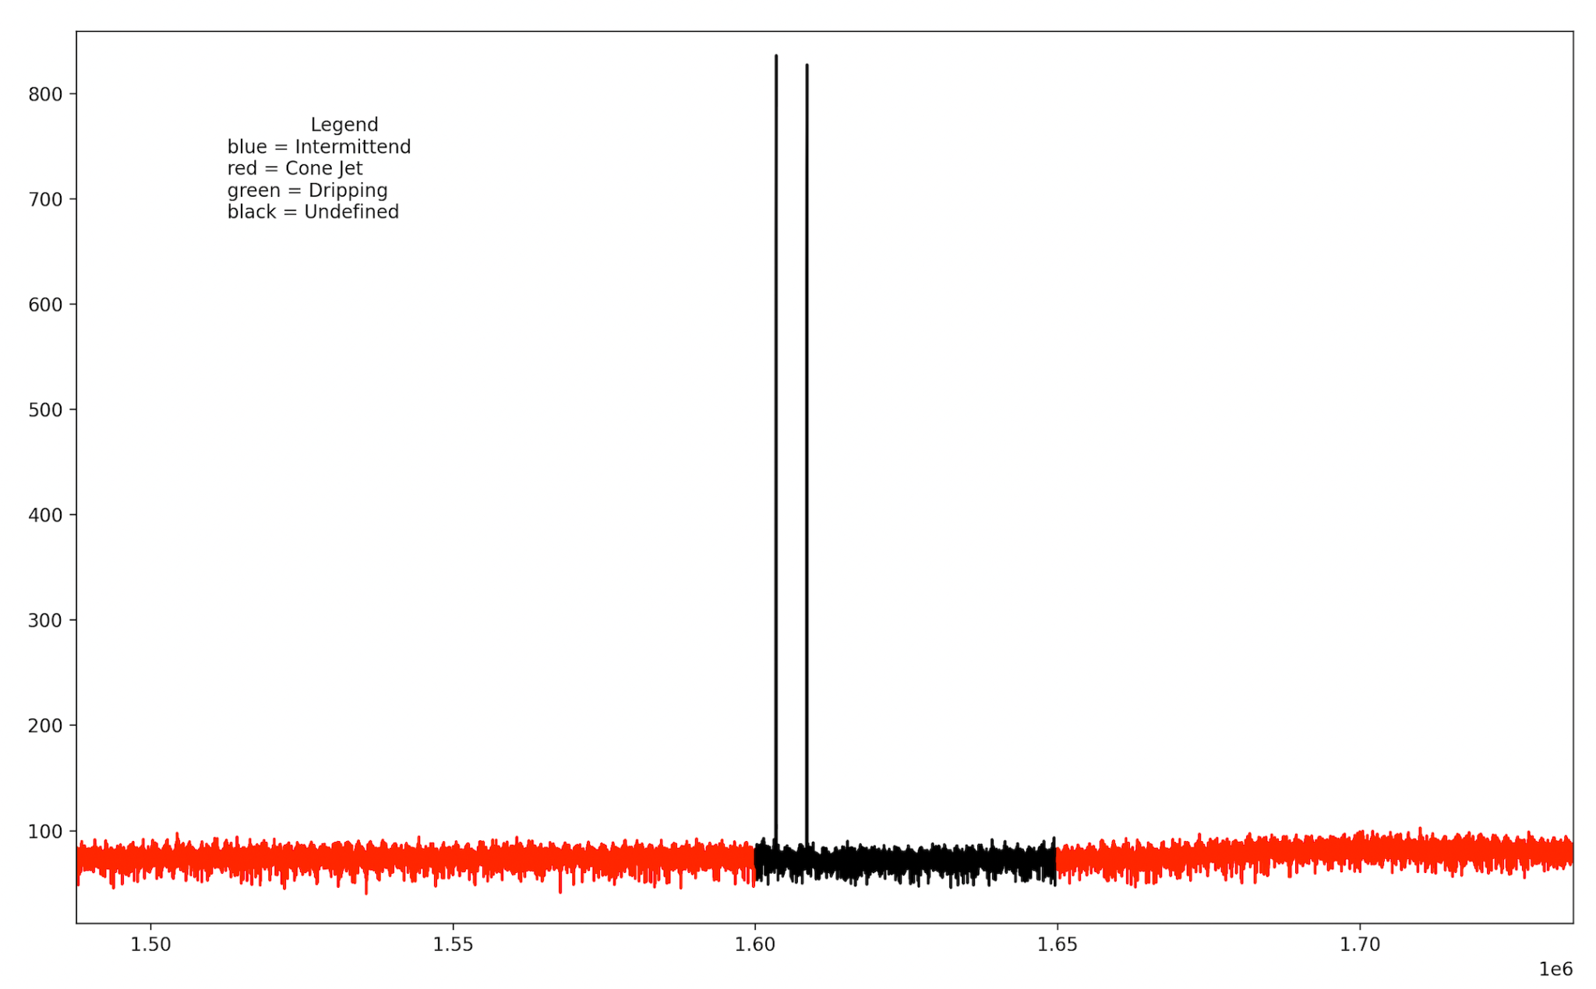
3 - Control System - first results
Flowrate perturbation robustness test
Camera trigger noise
1.5 mL/hr
3.5 mL/hr
5.5 mL/hr

Slide 10
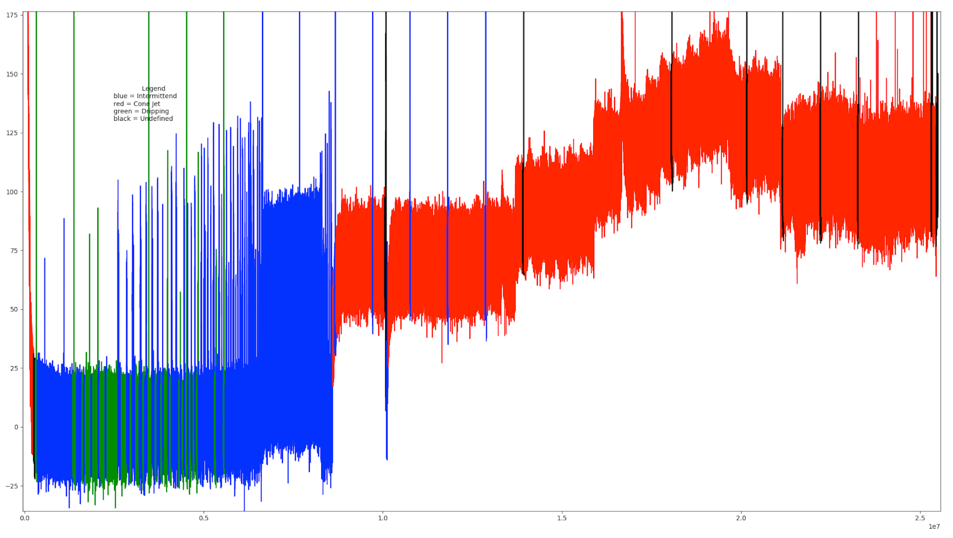
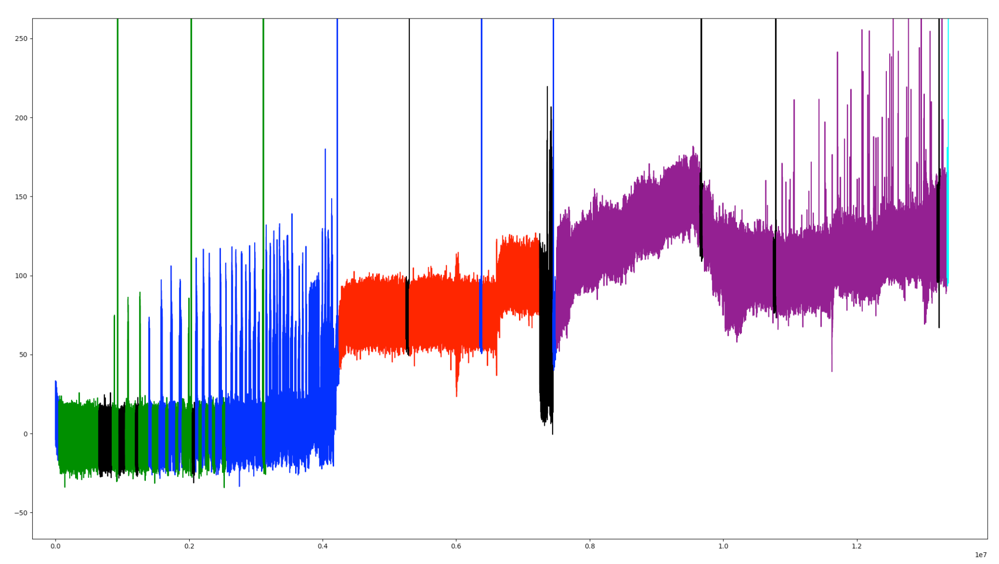
Manually correcting data Classification
Dripping
Intermittent
Cone Jet
Multi Jet - Not Classified
Corona Sparks

Slide 11

Thanks!

